Slide 1
Tautoko Rā Kaiako
The Ako Framework; its principles, approaches and high-quality teaching practices to support learning
Tua Rua : Whiringa-ā-rangi 2023

Slide 2
Ako – Principles, approaches, and high-quality teaching practices
In Teacher Only Day Two we are exploring Ako - principles, approaches, and high-quality teaching practices to support learning, (Ako Framework).
We recommend 30 - 40 minutes for each wānanga.
Introduction: Ako – Principles, approaches, and high-quality teaching practices
Wānanga 1: The mātāpono (principles) of the Ako Framework.
Wānanga 2 : The pedagogical approach: All kaiako are teachers of mokopuna.
Wānanga 3: The pedagogical approach: All kaiako are teachers of language.
Wānanga 4: The pedagogical approach: All kaiako are teachers of learning.
Wānanga 5: Explore high-quality teaching practices.

Slide 3
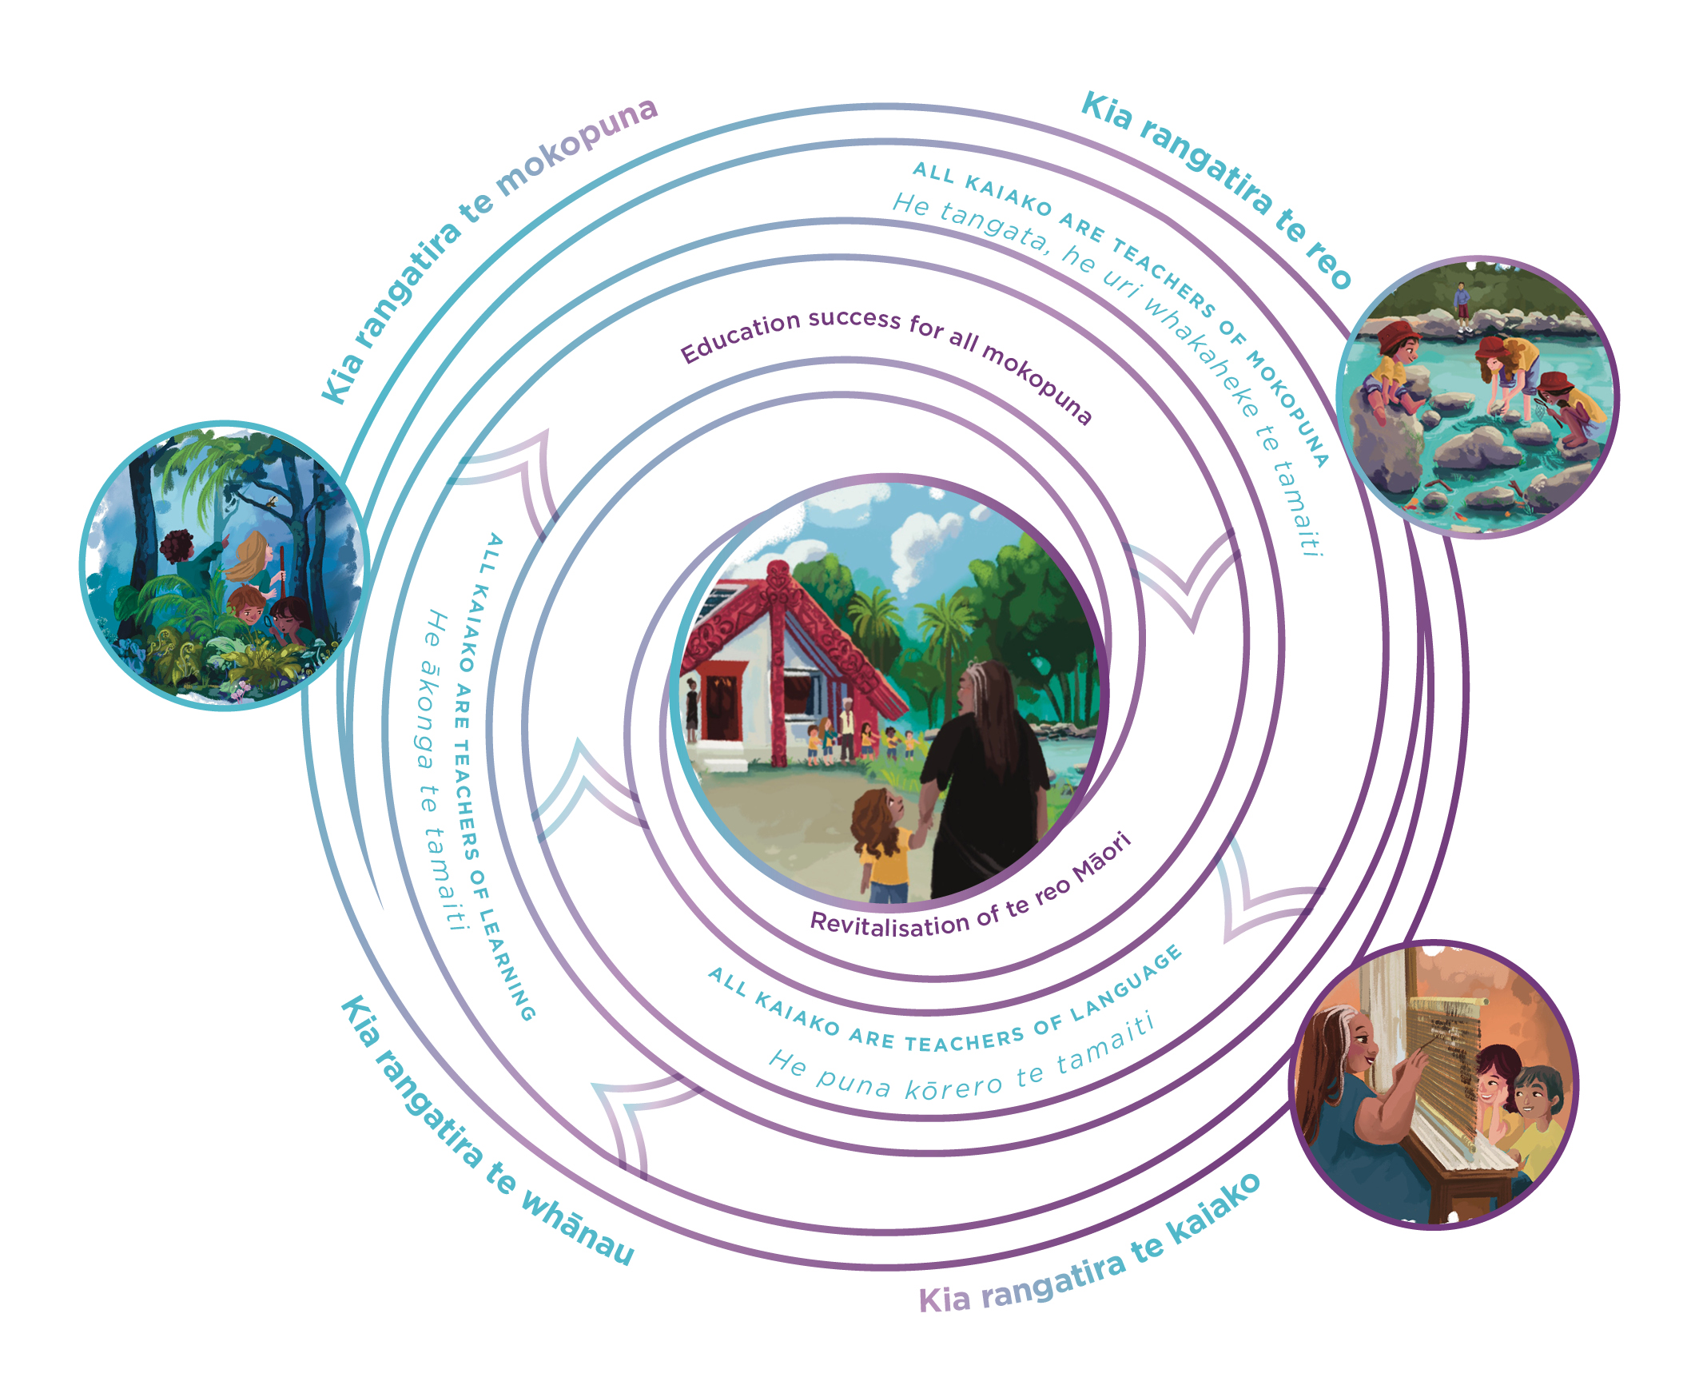

Support to engage with this resource
Each wānanga give you, your staff and the school board an opportunity to self-reflect on the principles, approaches, and practices you advocate and use in your kura.
You can engage in the Ako Framework to confirm if the principles, approaches and teaching practices resonate with your kura and whānau and/or confirm if some things are missing.
When complete, the wānanga will have provided a space to introduce, consider, and question the Ako Framework as a collective.
Following the wānanga, some of the attached resources provide a space for greater self-reflection with similar questions for kaiako and their practice.

Slide 4
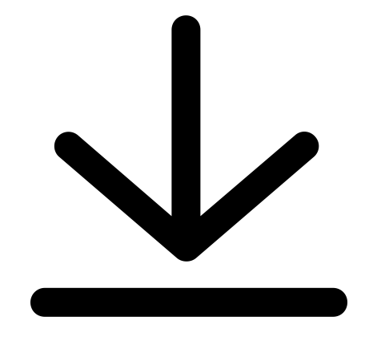
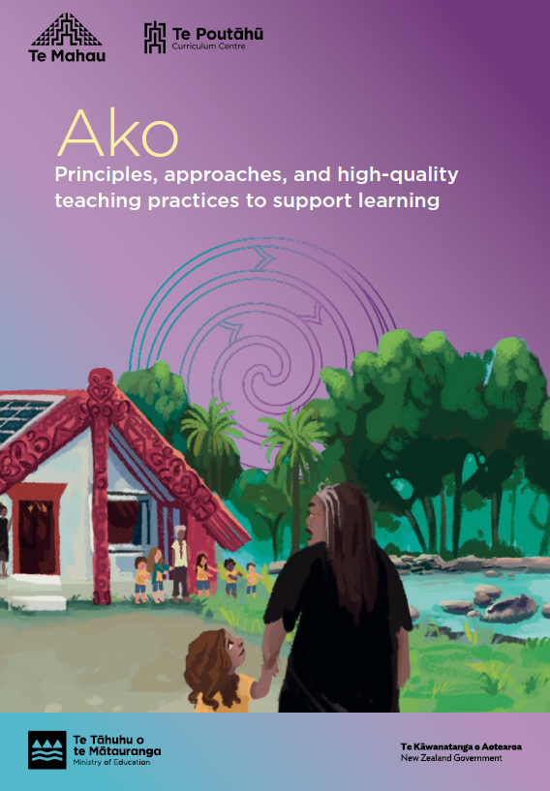
Introduction
Ako
Principles, approaches, and high-quality teaching practices to support learning ​
Rauemi tautoko

Slide 5
Key Messages
Ngā whāinga matua e rua
Revitalisation of te reo Māori
Education success for all mokopuna
Kaupapa Māori and Māori medium education stems from the hopes and dreams of whānau, hapū, and iwi for their mokopuna and these whāinga matua strive to shape learning and teaching for mokopuna in ways that are meaningful for them their whānau, hapū, iwi and communities.
Te Tīrewa Marautanga o Aotearoa (Te Tīrewa Marautanga) promotes ako as the pedagogical approach to achieving these strategic outcomes in an indigenous education pathway. Ako involves embedding consistent, high-quality teaching and learning practices (tikanga ako) across the curriculum for all mokopuna throughout their years at kura.
Tikanga ako can be considered from a mokopuna perspective and with a focus on what mokopuna do in the teaching and learning process. Tikanga ako can also be considered from a kaiako perspective.
The document focuses on what kaiako do in the teaching and learning process and highlights the key approaches that underpin high-quality teaching practices.

Slide 6
Wānanga 1
Read the mātāpono (principles) that guide the Ako Framework and work through the wānanga suggestions. ​

Slide 7
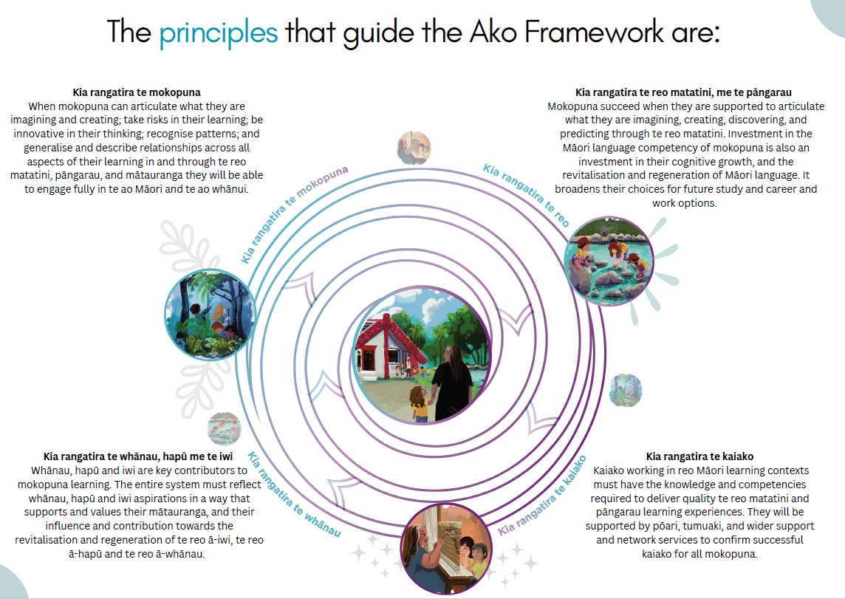

Slide 8
Ako Framework – Ngā mātāpono (Principles)
There are four mātāpono (principles) that underpin the quality teaching and learning approaches and practices that constitute tikanga ako.
Kia rangatira te mokopuna
Kia rangatira te reo
Kia rangatira te whānau
Kia rangatira te kaiako
Ako strengthens and enhances mokopuna achievement.
Ako strengthens the natural and ongoing language development of mokopuna voice and language. Ako also supports the regeneration of Māori language as expressed in the whakataukī, ‘Ko te reo kia rere, te reo kia tika, te reo kia Māori.
Ako recognises the ongoing advancement of whānau as key to mokopuna growth and achievement. Ako also acknowledges whānau as the natural, first, and lifelong kaiako of mokopuna, and the importance of their participation in and contribution to the education journeys of mokopuna.
Ako recognises the critical role of kaiako as being continually strengthened to support mokopuna success.
Hei wānanga:
As a kaiako, which of the mātāpono are most visible in your practice? What examples can you share?
As a kura, there are other documents or places that share similarities to the mātāpono in the ako framework; Te Tīrewa Marautanga, Te Tamaiti Hei Raukura. What similarities do they share with your own mātāpono?
How might whānau share that they can see, hear, and feel the mātāpono in their mokopuna at kura? Does your kura have other mātāpono that whānau value?

Slide 9
Wānanga 2
Read about the pedagogical approach -
All kaiako are teachers of mokopuna.​
Work through the wānanga suggestions.

Slide 10
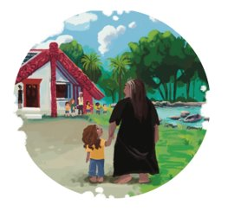
Ako Framework – Pedagogical approaches
This Tikanga ako focuses on the approach that all kaiako are teachers of mokopuna.
Ako requires kaiako to affirm and value the whole child, to support their wellbeing, identity, and development in order that they thrive as Māori in their world. Every kaiako is, first and foremost, a teacher of mokopuna. Each mokopuna possesses inherent qualities and strengths passed down through their whakapapa and acquired through life experiences, that can contribute to their learning and development.
Through purposeful practice and the provision of thoughtfully designed learning opportunities, kaiako can positively impact mokopuna dispositions and strengths. Successful mokopuna are self-assured in their identity and how they contribute and fit into their communities."
Hei wānanga:
As a kaiako, what examples can you share where your teaching practice affirms the ‘whole child’?
As a kaiako of mokopuna, what examples can you think of that shares the teaching space with mokopuna to support their own learning?
What is the shared understanding as a kura on how to support mokopuna dispositions and strengths?
What examples can you share, either as a kaiako or kura where learning was driven and led by mokopuna to whānau?
*Learning Dispositions: Learning dispositions are inherent traits and attitudes that shape one's approach to learning. They encompass attributes like curiosity, resilience, adaptability, and a growth mindset, influencing how individuals engage with and navigate the learning process.

Slide 11
Wānanga 3
Read about the pedagogical approach -
All kaiako are teachers of language.
Work through the wānanga suggestions.
​

Slide 12

Ako Framework – Pedagogical approaches
This Tikanga ako focuses on the approach that all kaiako are teachers of language.
Ako requires kaiako to support every mokopuna so that they can understand and effectively communicate concrete and abstract ideas in different cultural, social, and learning contexts. Language is essential for every mokopuna to communicate and learn. Successful mokopuna possess the ability to articulate and exchange their own thoughts, emotions, and concepts as well as understand the thoughts, feelings and ideas of others.
Kaiako systematically share with mokopuna signs and symbols (visual, verbal, and non-verbal) and support them to use those signs and symbols purposefully, correctly, and effectively so that mokopuna are proficient communicators, engagers, and evaluators of ideas, able to articulate their thoughts, opinions, feelings, and understandings as confident users of te reo matatini.
Hei wānanga:
As a kaiako, how different does your language learning journey look, feel and sound to mokopuna in your classroom?
How many ways can mokopuna express different forms and modes of language in your classroom?
As a kaiako of mokopuna, what have you found to be the critical components mokopuna need to learn a language?
As a kura what is your language commitment in your strategic documents?

Slide 13
Wānanga 4
Read about the pedagogical approach -
All kaiako are teachers of learning.
Work through the wānanga suggestions.

Slide 14

Ako Framework – pedagogical approaches
This Tikanga ako focuses on the approach that all kaiako are teachers of learning.
Kaiako explain what is being learnt and why, the strategies mokopuna can use to learn, and the outcomes they can expect so that mokopuna know what they are learning, how they can learn it, why it matters and how they will know that they have been successful.
Ako requires kaiako to encourage mokopuna participation in their own learning and showing them how to become effective learners. This means teaching mokopuna how to describe and reflect about what they are learning so they can develop as confident, skilled problem solvers, and creative thinkers. Like Ako, diverse and innovative teaching and learning occurs in meaningful and practical ways and is inclusive of the contribution from te taiao.
Hei wānanga:
Reflecting as a mokopuna what were your best learning moments that you might describe as innovative and meaningful?
As a kaiako, what skills and techniques do mokopuna know how to use if they are stuck in their learning?
In our kura, what collective strategy do we share, so mokopuna can describe and reflect about what they are learning?
Thinking of our whānau, how might we be able to use their knowledge and skills to support mokopuna learning; how might they like to be involved?

Slide 15
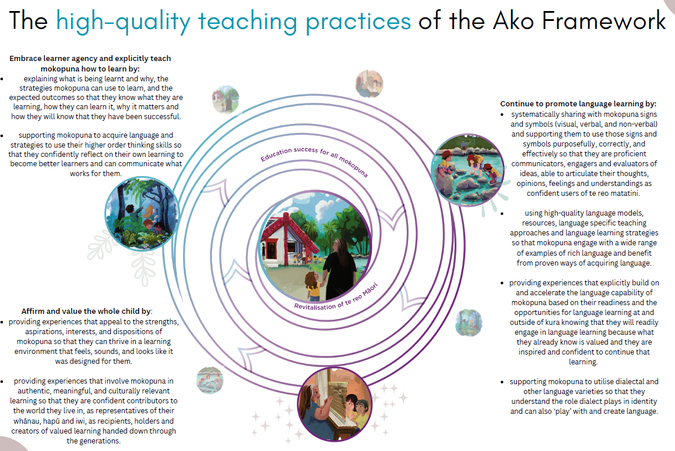
Wānanga 5
Read The high-quality teaching practices of the Ako Framework and work through the wānanga suggestions. ​
Rauemi tautoko

Slide 17
High-Quality Teaching Practices
Affirm and value the whole child by:
Providing experiences that appeal to the strengths, aspirations, interests, and dispositions of mokopuna so that they can thrive in a learning environment that feels, sounds, and looks like it was designed for them.
Continue to promote language learning by:
Providing Te Ao Māori experiences that develop mokopuna to be proficient, communicators, engagers and evaluators of ideas, able to articulate their thoughts, opinions, feelings and understandings as confident users of te reo matatini.
Embrace learner agency and explicitly teach mokopuna how to learn by:
Supporting mokopuna to acquire language and strategies to use their higher order thinking skills so that they confidently reflect on their own learning to become better learners and can communicate what works for them.
Hei wānanga:
As a kaiako, which of the high-quality teaching practices are visible in your practice? What examples can you share?
How might whānau contribute to these teaching practices?
What is the shared understanding as a kura on high-quality teaching practices?
*Learning Dispositions: Learning dispositions are inherent traits and attitudes that shape one's approach to learning. They encompass attributes like curiosity, resilience, adaptability, and a growth mindset, influencing how individuals engage with and navigate the learning process.

Slide 18


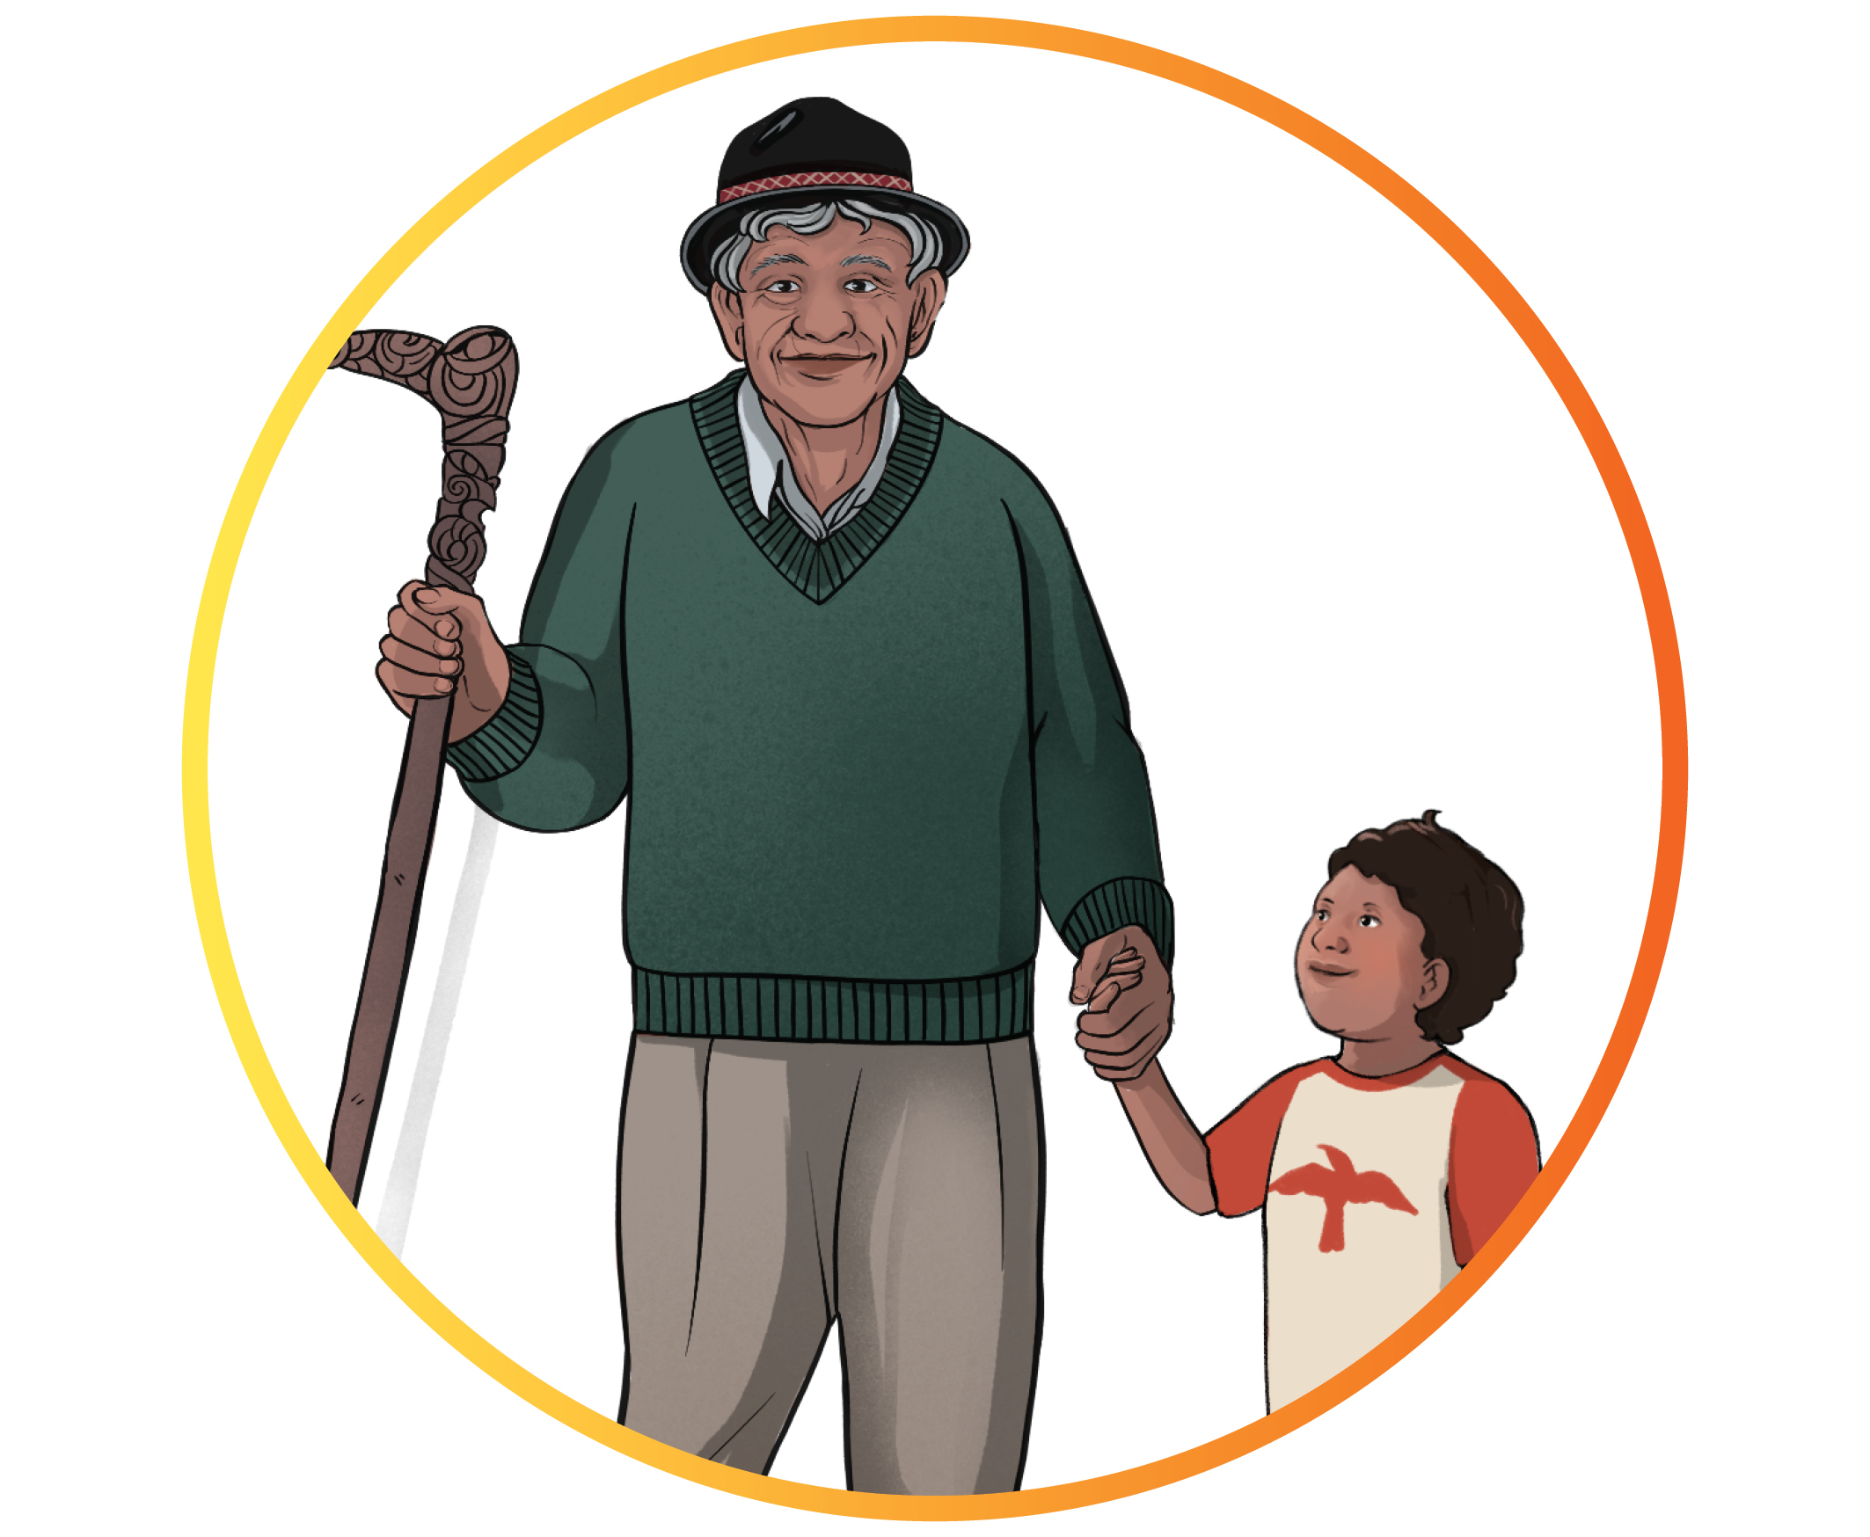
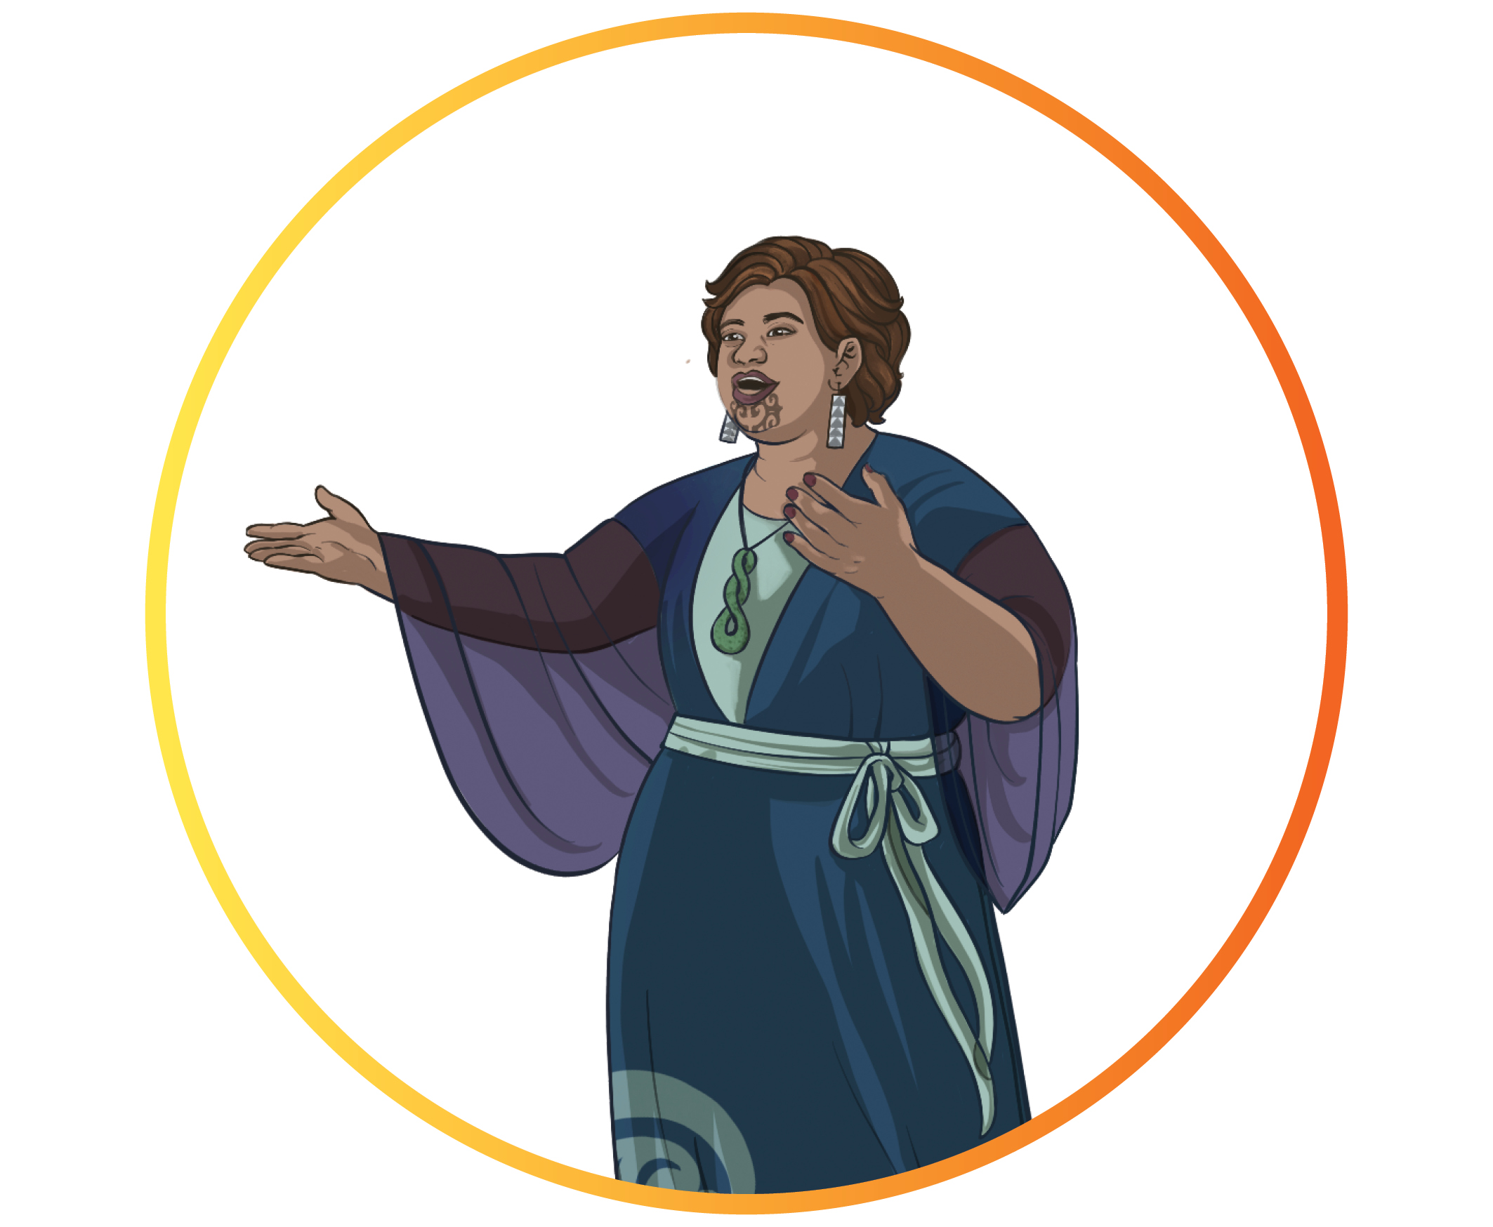
He aha e whai ake nei?
By TOD 3 The Ako Framework will be updated with feedback from targeted engagements.
Tēnā, tuarihia te katoa o ngā urupare kia taea ai e mātou te whakapai ake ngā ihirangi ka whakawāteahia ai mō te Tautoko Rā Kaiako e whai ake nei tukuna ki TeReo.MaoriGroup@education.govt.nz

